Slide 1


WHAT REDDIT USERS THINK AND TALK ABOUT EUROPEAN CITIES?
PABLO YUSTE – 100406674
GONZALO TOMAS – 100406615
JAVIER ICAZA – 100406598
RICARDO ESTAIRE - 100406711

Slide 2
INDEX
1. OUR IDEA
2. REDDIT API
3. DATA ANALYSIS
4. INTERACTIVE DASHBOARD
5. STATE OF THE ART
6. CONCLUSIONS

Slide 3
0UR IDEA
GET TO KNOW WHAT REDDIT USERS TALK ABOUT CITIES
STABLISH RELATIONSHIPS BETWEEN CITIES
FIND MOST COMMON TOPICS WHEN DISCUSSING ABOUT CITIES
CLASSIFICATION OF EUROPEAN CITIES BASED ON WHAT USERS THINK

Slide 4
WHY CHOOSE THIS PROJECT?
COULD BE USEFUL TO PLAN FUTURE TRIPS
DISCOVER WHAT PEOPLE AROUND THE WORLD THINK ABOUT EUROPEAN CITIES

Slide 5
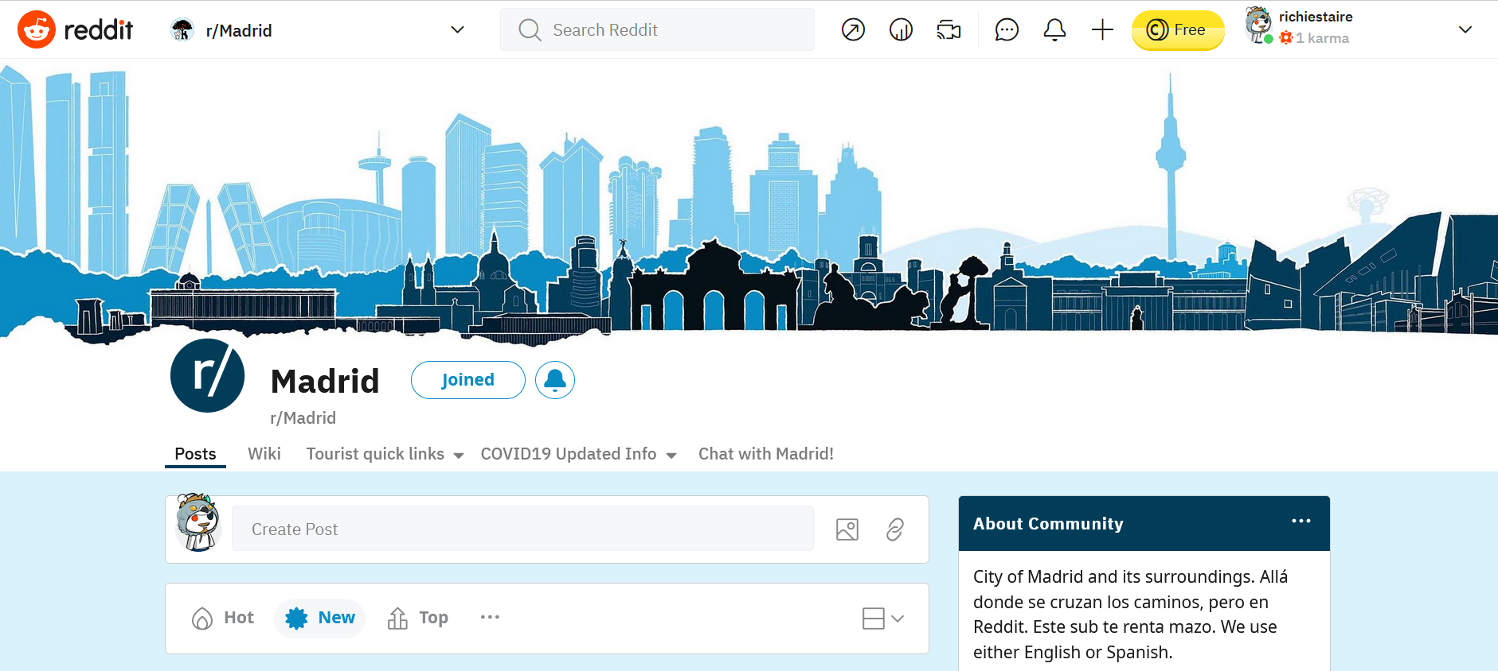
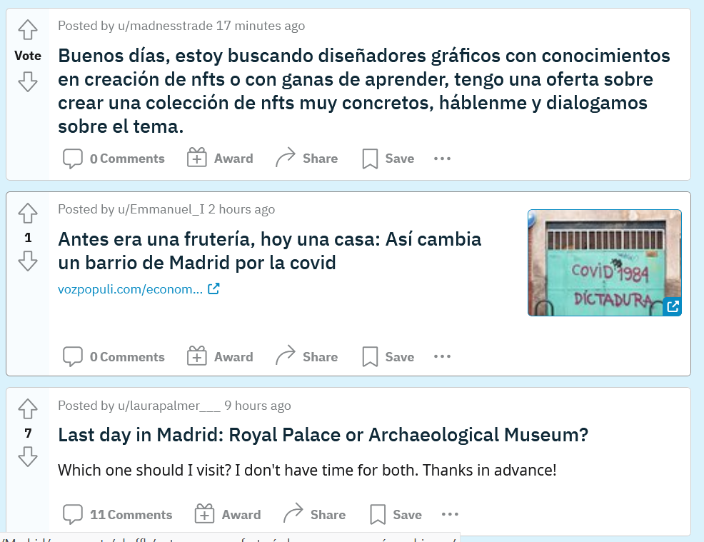
HOW IS REDDIT ORGANIZED?
ORGANIZED IN COMMUNITIES WHERE USERS POST QUESTIONS, SUGGESTIONS OR STORIES.
ALL USERS CAN MAKE POSTS IN ALL COMMUNITIES AND OTHER USERS REACT TO THOSE POSTS
IT IS POSSIBLE TO FILTER POSTS BY HOT, NEW, TOP and RISING

Slide 6
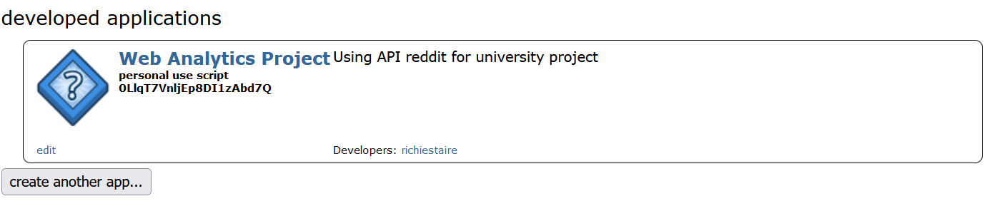
GET THE DATA FROM REDDIT
CREATED AN APPLICATION TO RETRIEVE THE DATA
LEARNING HOW TO USE THE API WITH THE HELP OF
https://www.reddit.com/dev/api/
USE DATA FROM THE COMMUNITIES OF MADRID, BARCELONA, LONDON, PARIS, ROME, BUDAPEST, PRAGUE, BERLIN, VIENNA and STOCKHOLM

Slide 7
WHY REDDIT?
WANTED TO LEARN A DIFFERENT API
EASY TO GATHERED INFORMATION
REDDIT USERS CAN DISCCUSS WITHOUT LIMITATIONS

Slide 8
DATA ANALYSIS
NATURAL LANGUAGE PROCESSING
REGRESSION
CLASSIFICATION

Slide 9
NATURAL LANGUAGE PROCESSING
OBTAIN THE MOST DISCUSSED TOPICS IN EACH CITY
SENTIMENT ANALYSIS TO KNOW HOW USERS FEEL ABOUT EACH TOPIC
CLASSIFY WHAT CITIES USERS LOVE THE MOST
SUGGEST TOPICS TO POST FOR USERS WHO WANT TO RECEIVE FEEDBACK

Slide 10
REGRESSION & CLASSIFICATION
GET TO KNOW THE BEST TIME OF THE YEAR TO CREATE A TOPIC
PREDICT THE NUMBER OF ANSWERS A TOPIC WOULD RECEIVE DEPENDING ON THE CITY
CLASSIFY THE MOST IMPORTANT TOPICS OF EACH CITY
OBTAIN WHAT TOPICS ARE MORE DISCUSSED EACH SEASON

Slide 11
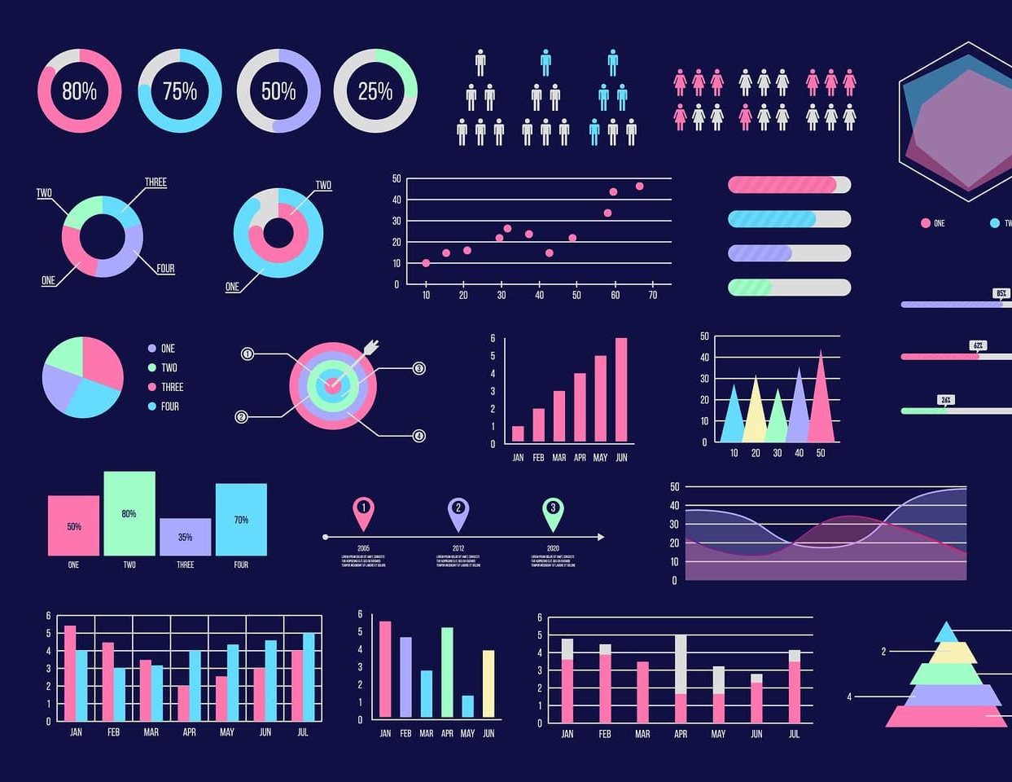
INTERACTIVE DASHBOARD
USING https://streamlit.io/ CREATE A DASHBOARD
NAVIGATE THROUGHT CITIES
SHOW RESULTS WITH PLOTS AND CHARTS
COMPARE CITIES
DOWNLOAD A REPORT FOR EACH CITY

Slide 12
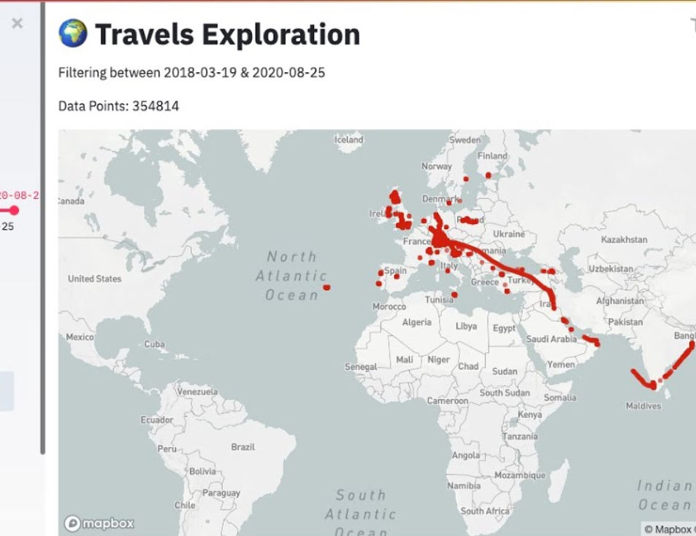
ONE CITY → ONE DASHBOARD
SET UP A MAP TO INTERACTIVELY CHOOSE THE CITY OR LOOK UP FOR THE CITY IN A SEARCH BOX
SET UP A CALENDAR TO PICK A PERIOD OF TIME TO SHOW THE BEST RESULTS

Slide 13
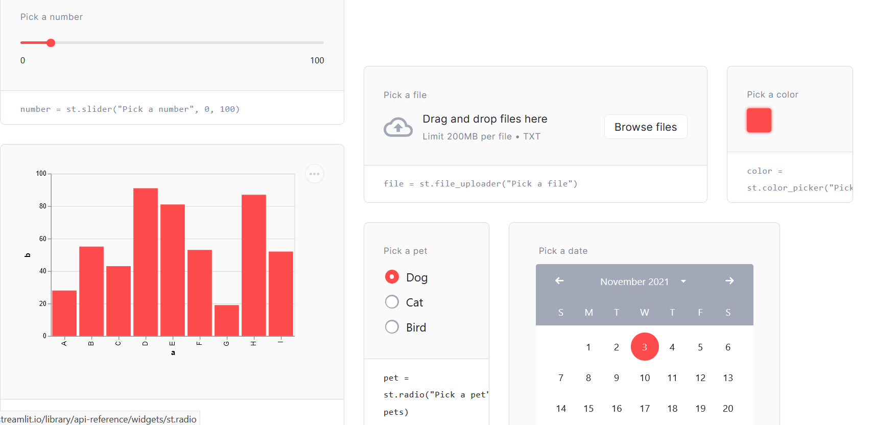
DASHBOARD CONNECTED TO JUPYTER
OUR DASHBOARD WILL BE CONNECTED TO A JUPYTER NOTEBOOK
SELECT DATES AND CITY & AUTOMATICALLY SHOW THE RESULTS

Slide 14
RELATED WORKS
The Tweet and the City: Comparing Twitter Activities in Informational World Cities.
https://www.researchgate.net/publication/265418023_The_Tweet_and_the_City_Comparing_Twitter_Activities_in_Informational_World_Cities

Slide 15
CONCLUSIONS
GET TO KNOW WHAT REDDIT USERS DISCUSS ABOUT CITIES
NATURAL LANGUAGE PROCESSING, REGRESSION AND CLASSIFICATION MODELS
INTERACTIVE DASHBOARDS TO SHOW RESULTS

